Slide 1
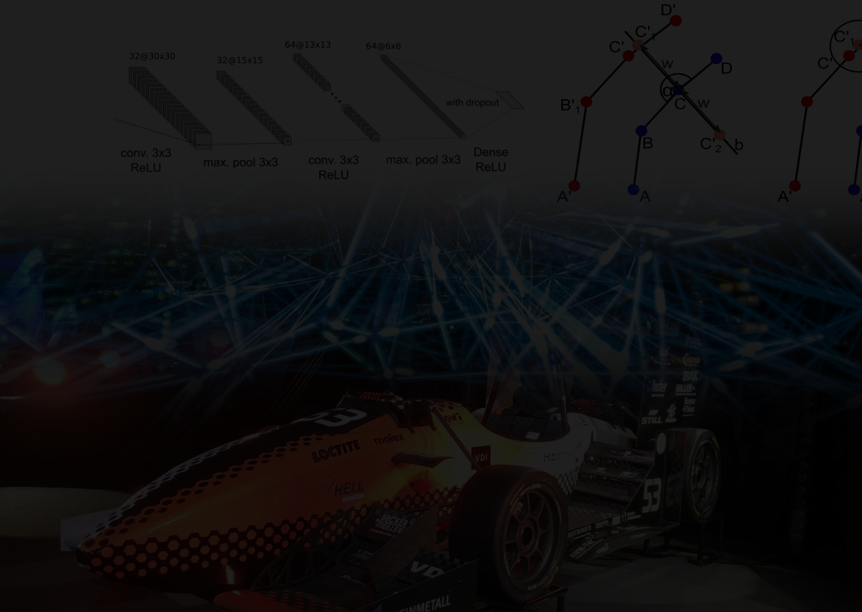
Map Generation in Autonomous Racing
A Comparision of a Classic Heuristical Algorithm and Machine Leaning
Notes:
Hello, Like to present to you my bachelors theses: Map Generation in Autonomous Racing - A Comparision of a Classic Heuristical Algorithm and Machine Leaning

Slide 2
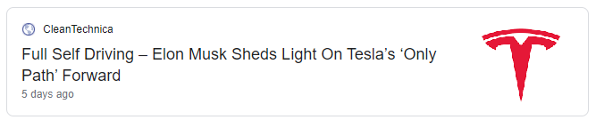

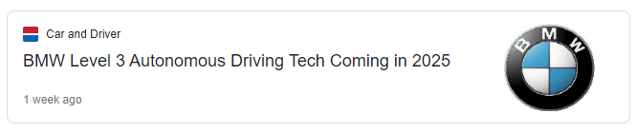
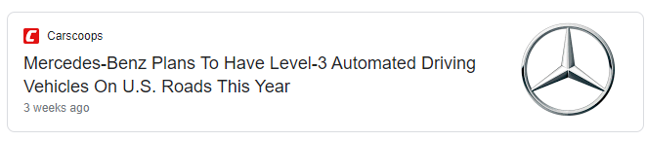
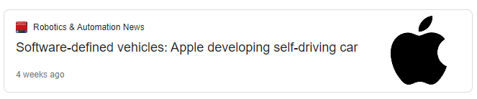
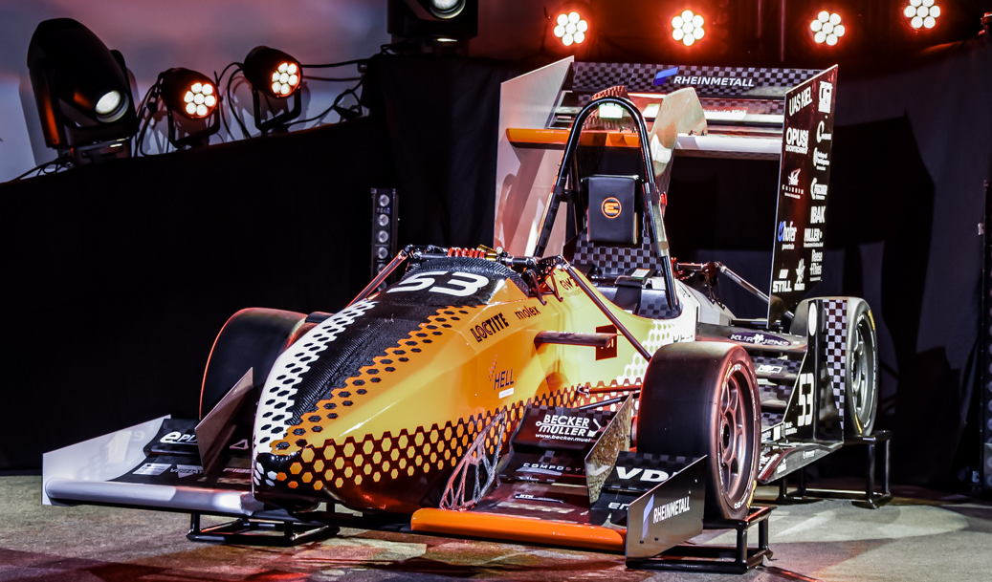
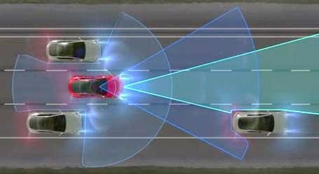
Why Map generation?
Major car brands looking into
self driving
Implement autonomous driving
in Raceyard too
+
Notes:
So why map generation, and what to do with autonomous racing?
Having look at major car manufactors, actively looking into autonomous driving. It just takes a look at the recent news to see that tesla, ford, bmw, mercedes, even apple recently joined efforts to develop fully autonomous vehicle to be used on streets within the next few years.
How cool implement this technology at our local formula student team raceyard. To make their race cars race autonomously along their tracks
That’s goal raceyard, to compete in driverless discipline in formula student, to make this car [photo], race autonomously without any driver
So, what do need, to make this car fully autonomous?

Slide 3
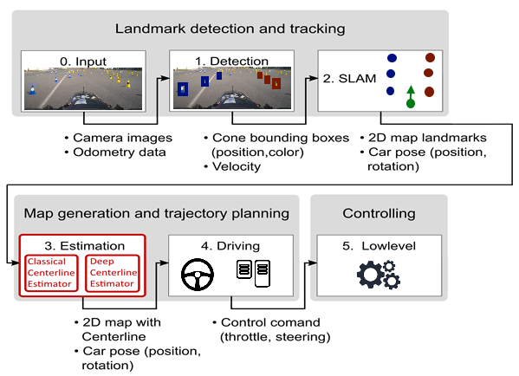
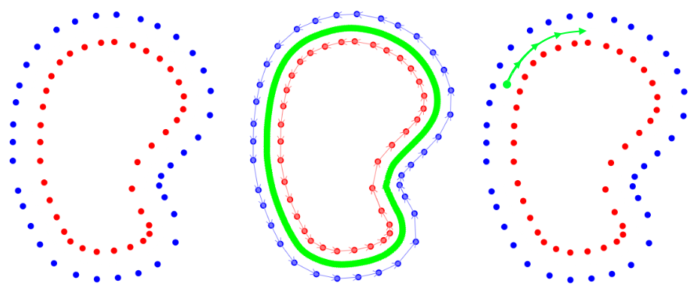
Autonomous pipeline
Sensory Input, Landmark detection and tracking (SLAM)
Map generation and trajectory planning:
- Generation of an Abstract map
- Planning actions to follow map
Controlling the vehicle (same as non autonomous)
Notes:
Can be split into 3 parts, sensory input, the detection [follow onscreen text] [compare to pipeline]
The part marked in red, my contribution, to visualize, basically takes map, classical calculates out centerline, ml curvatures that model course ahead

Slide 4
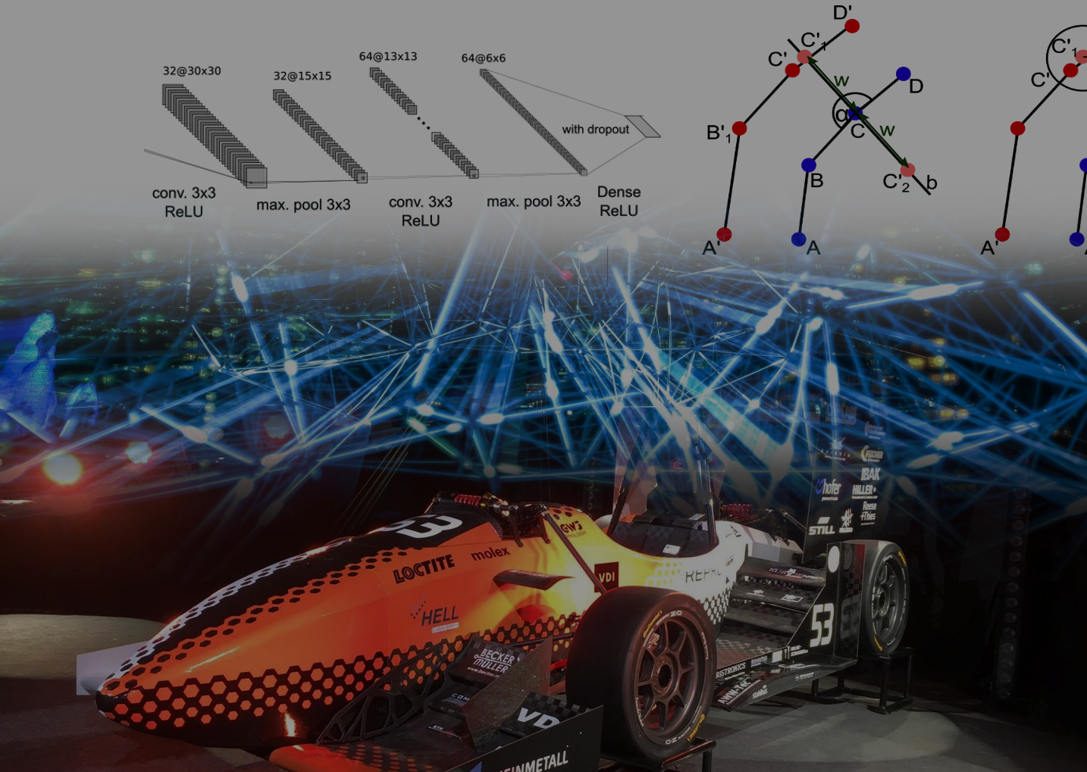
Outline
Goals (Raceyard)
Foundations
Machine Learning
Discrete Curvature
Development environment
Methods
Classical approach
Machine learning approach
Evaluation
Analysis
Comparison
Conclusion
Notes:
Now that you, hopefully understand that my work good for, lets talk about these to approaches lil more detailed,
details the goals more precisely that this thesis alongasde implementation at raceyard trys to fulfill.
To understand the methods I used for implementing the map generation, I will briefly introduce some foundations, alongaside the development environment used to prototyping the ideas
After weve established that, I will present the two approaches ive taken, whose performance I will analyse and compare to draw a conclusion how each implementation could be used in future

Slide 5
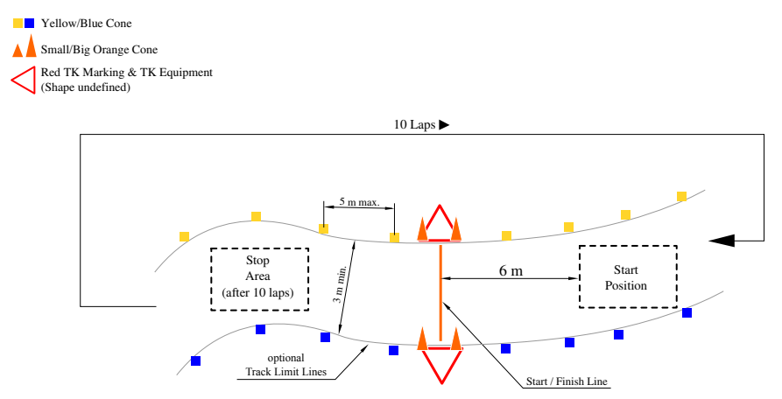
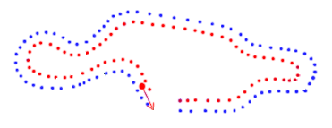
Goals
Solve map generation, necessary to drive autonomously in FSD
Improve on existing classical algorithm
Implementation of novel ML algorithm
Goals:
Robustness
Misdetection
Non-detection
Over-detection
Better Runtime
Better utilization of SLAM Information
Notes:
Main goal established already, we need a map.
Furthermore, improve on existing previously worked classical approach to map generation
But also explore new machine learning aproach
In regards to the implementation, they the improved classical one and ml one, should have better robustness against mistdetection of cones, for exmaple wrong color, non-detection and over detection of cones
Also a better runtime so that the algorithms could be used in real time
And better utilization of all the data the slam provides

Slide 6
Foundations
Machine Learning
Discrete Curvature
Development environment
Notes:
Lets talk about the foundations for my aproaches

Slide 7
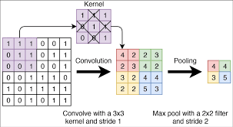
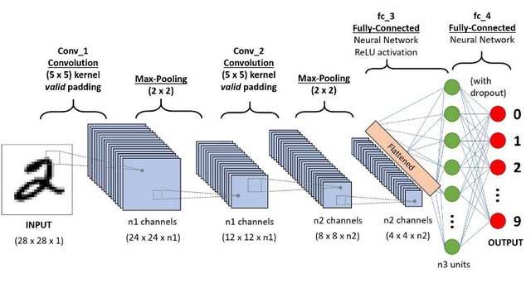
Machine learning – CNN
Primarily used for image input
Adds convolution layers, and pooling layers
Notes:
Special type of neural network, takes images as input, adds convolutional layers and pooling layers,
Convolutional layers convolve the input using a kernel, this means a certain local region is filtered using a matrix called kernel, [see in upper example] and summed up, done for each patch in the input
Pooling, for exmaple max pooling, just takes the biggest nummer of a certain region, as we can see, input size is heavly reduced, while only having 9 trainable parameters, the kernel,
Also perserves locality of features in the input, since kernel is applied everywhere. After these convolutional and pooling layers, usually some fully connected layers follow
, instead of deciding a class by looking at the output with the highest output strength, can be used for regressing, meaning computing a value, by using the output strength of a single output neúron directly

Slide 8
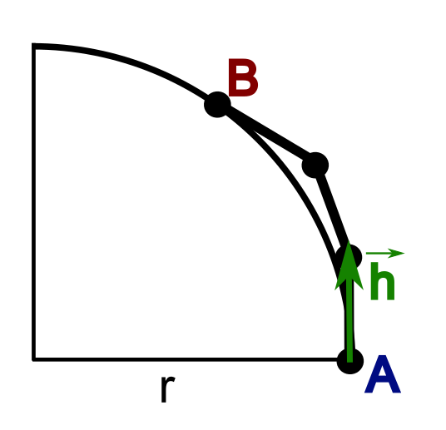
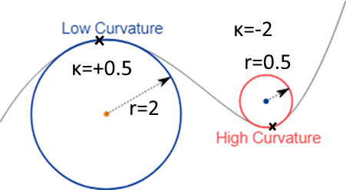
Discrete Curvature
CONTINUUS Curvature
Defined by two points, A and B and a heading in A
Used to approximate course of a polyline
1 / radius of touching circle
Sign indicates “direction”
Notes:
One important concept is curvature, curvature at a point on a continuus curve can be described by the circle that touches the curve in that point,
Also the sign indicates the cirection of the curvature, when ist positive ist going right, negative left, when read from left to right
When we have a discrete curve, such as a polyline, we need a more advanced definition, since the curvature alonge the straight parts would be 0 and in the vertices infinite
We can use 2 points plus a heading, with both points being on the circle and the heading being tangent, the heading can be derived by looking at the next point,
, this also gives us a quasi touching circle and by that a curvature for this discrete polyline from point A to B

Slide 9
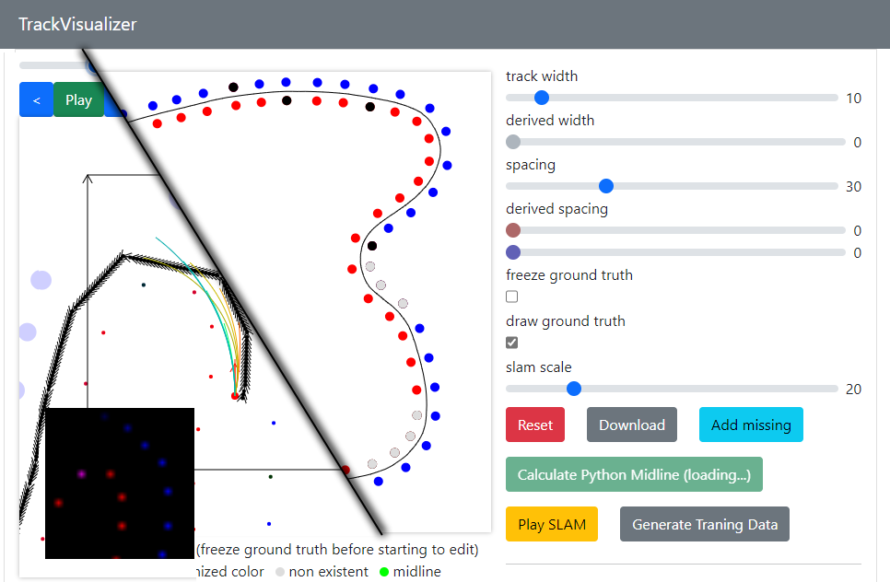
Development Environment
In Web technologies, HTML/CSS/JavaScript
Easy prototyping and sharing
Uses pyodide to execute python using WASM
Completely statically hostable, no backend need e.g.: github pages¹
Notes:
Showcast development environment i programmed to work on this project, because this is where effectively spend most time, prototyping and evaluating ideas, written in web technologies, allows for rapid prototyping and sharing, since pipeline and existing is in python, we use pyodide, which allows python execution in the browser using web assembly, notabily no cross compilation, and having support for many libraries, pandas, scipy – and such statically hostable for example at github pages, this url you can go and try the latest code i used for prototyping

Slide 10
Methods
Classical Algorithm
Machine Learning Algorithm

Slide 11
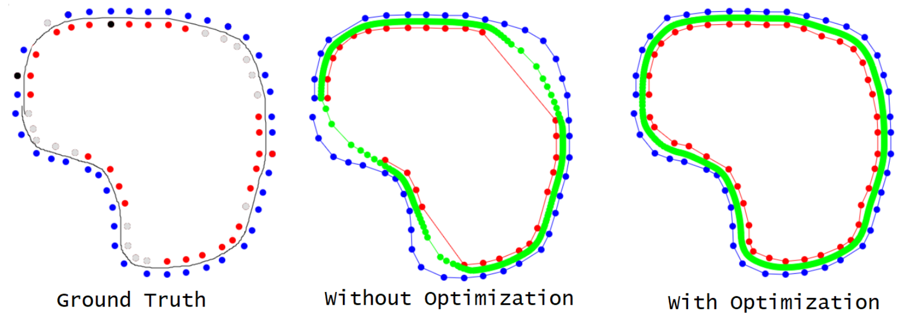
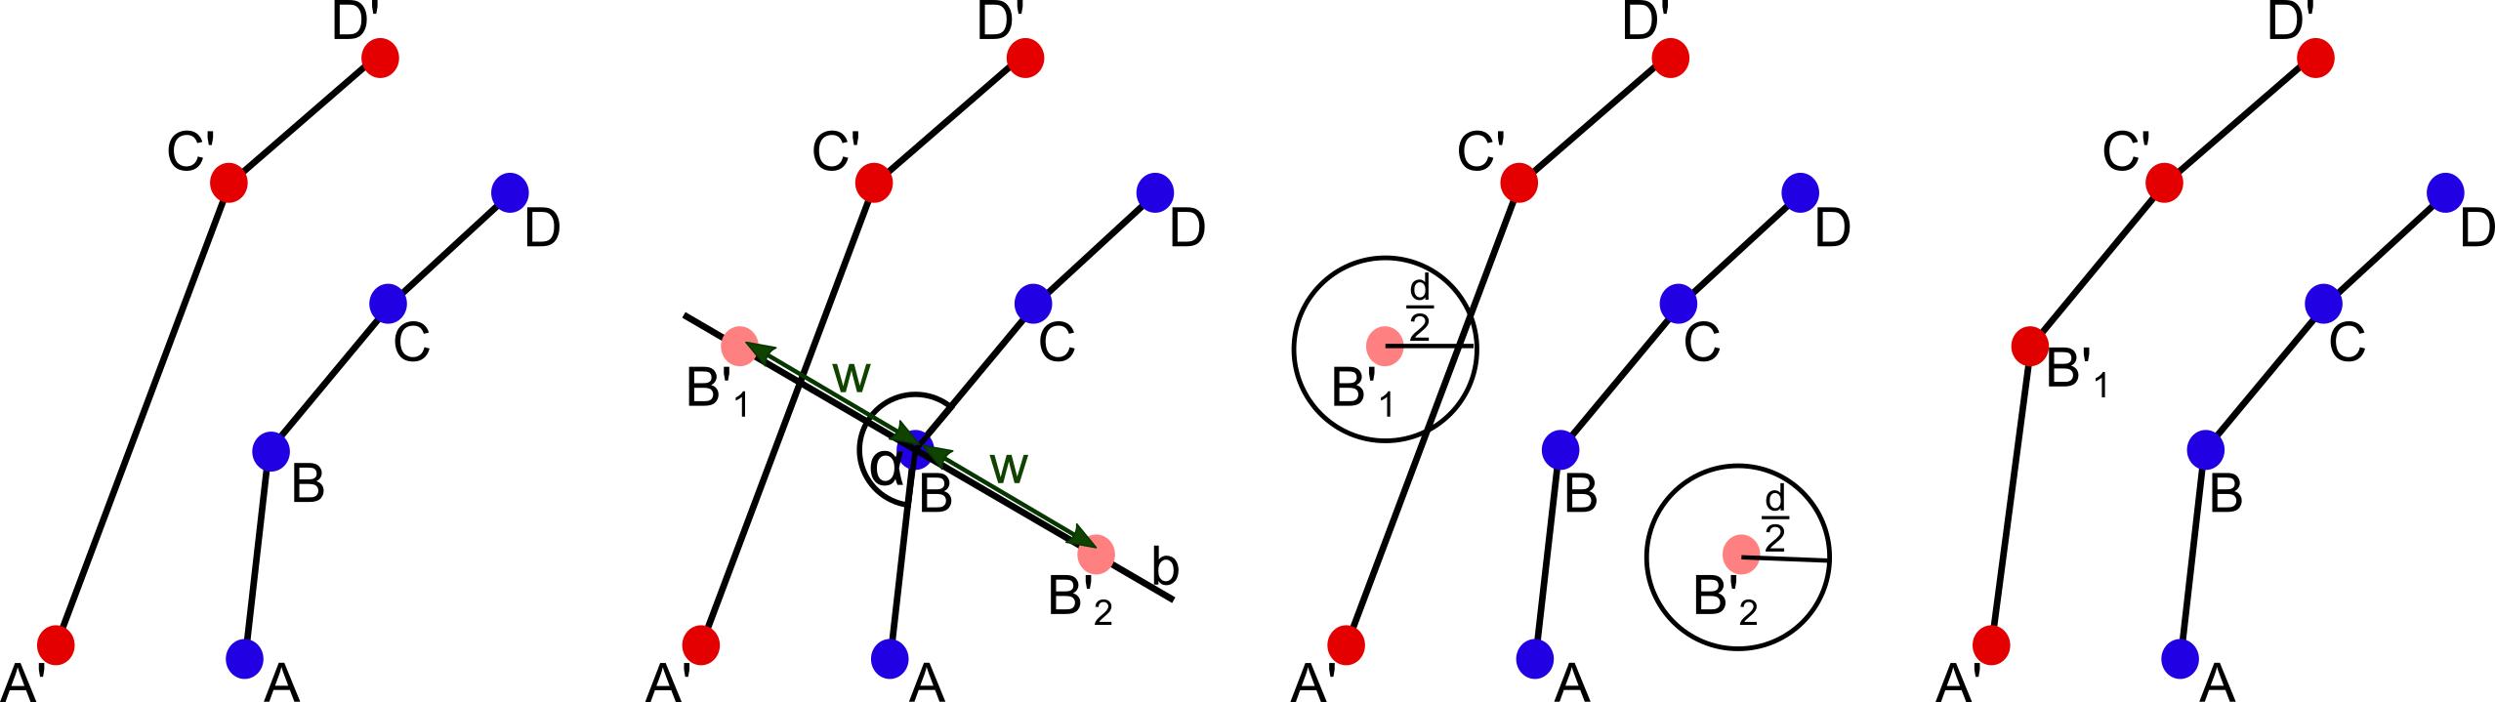
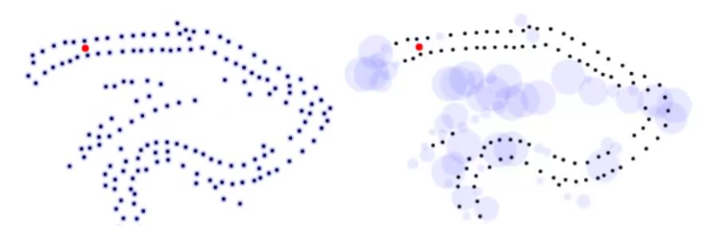
Classical Algorithm
Basis: Master Project by Vaishnav/Agrawal
Given pointcloud from slam calculate
centerline
Improvements
Spacial sorting using TSP Approximation
Readding of missing points
For each cone: guess position of corresponding cone
If none there add the guessed one
Incoorparaion of covariance

Slide 12
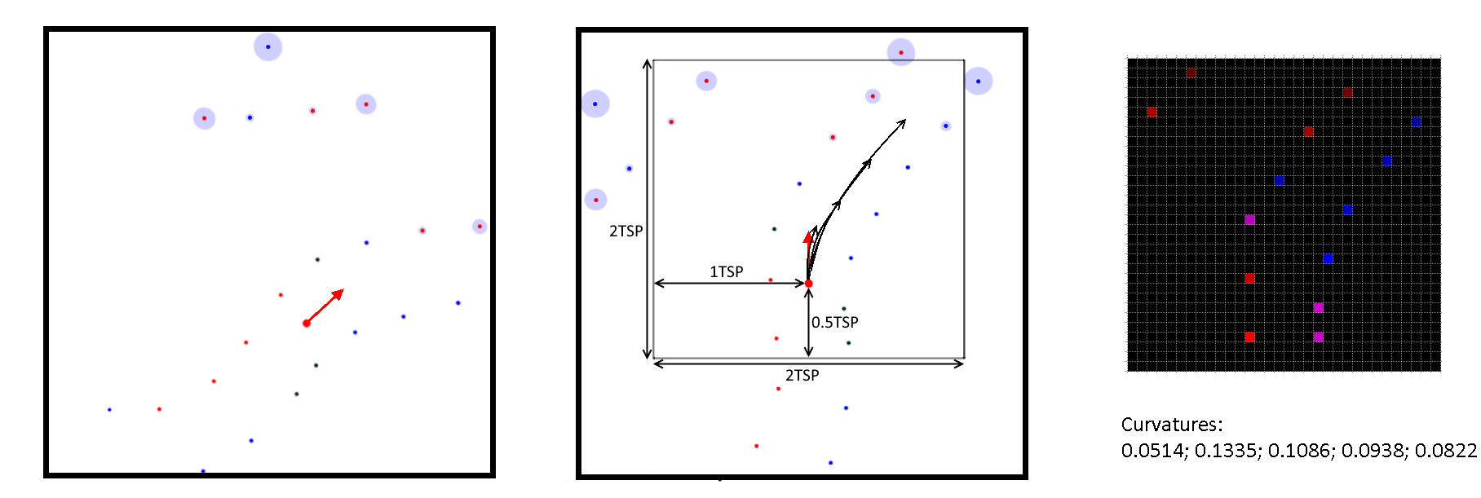
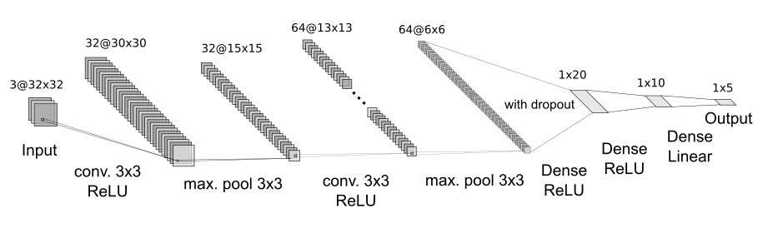
Machine learning Algorithm
Input/Output Design
Input: Immediate surrounding cones as image
Output: curvatures describing the course of track ahead
Standard CNN architecture

Slide 13
Evaluation
Analysis
Comparison

Slide 14
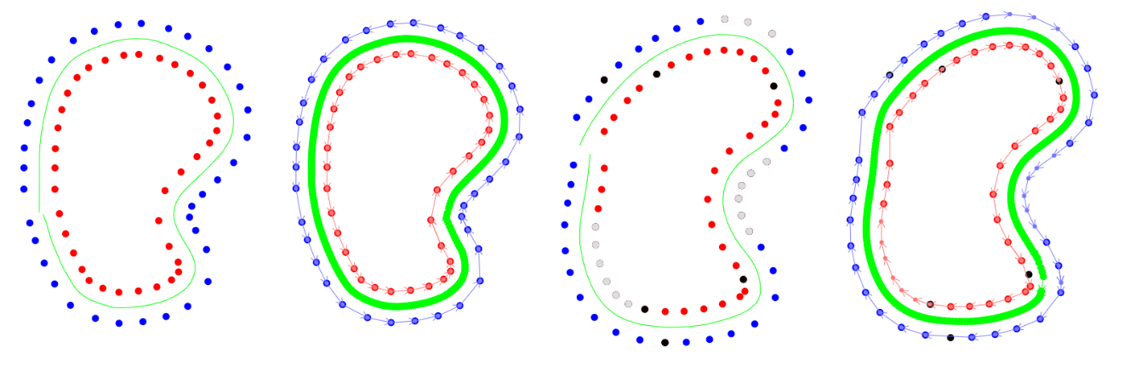
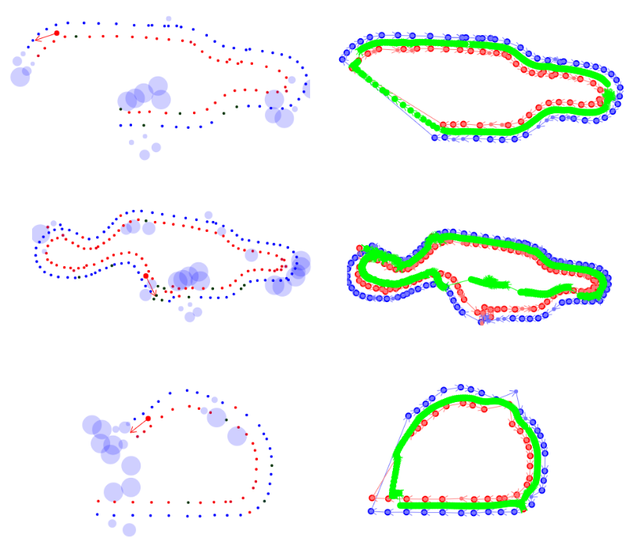
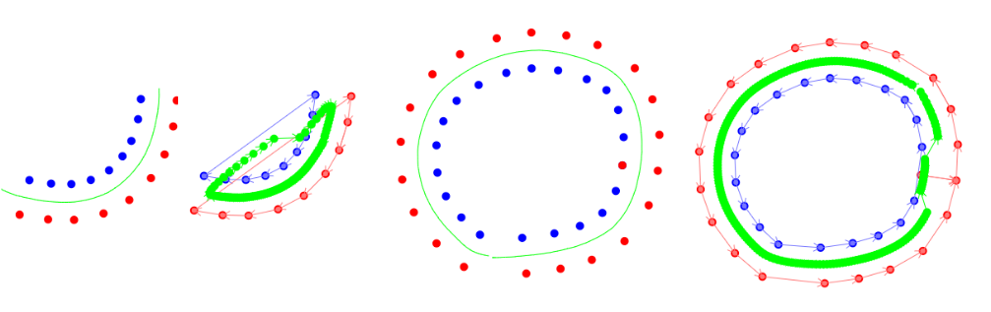
Analysis – Classical
Works well for simple cases:
non-detections
arbitrary cones sorting
With Simulated data
Sometimes good/sometimes not at all
Fails for more erroneous data
Incomplete tracks
misidentified colors
Notes:
All in all, less and less usable output increasing errors in the input, but if input very precise

Slide 15
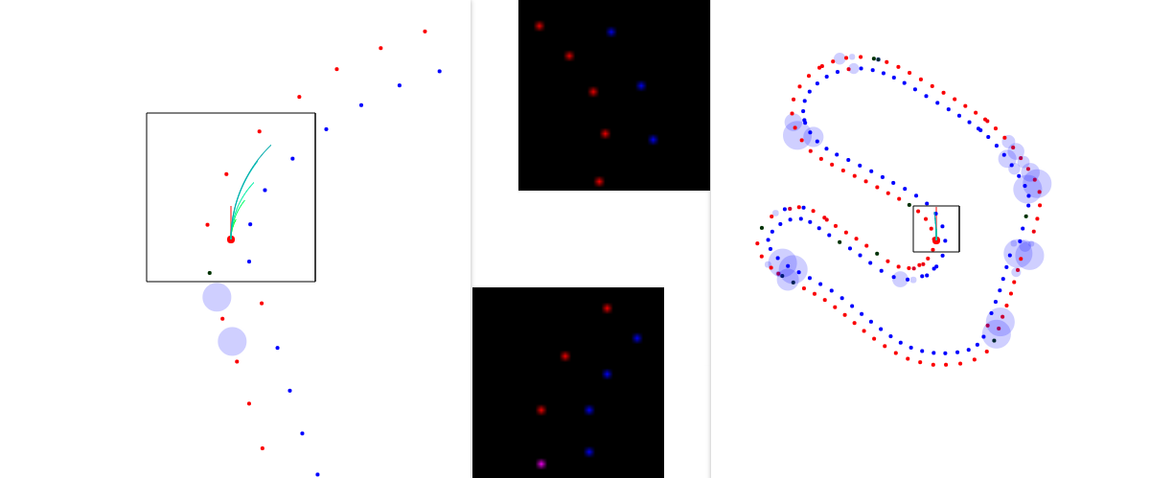
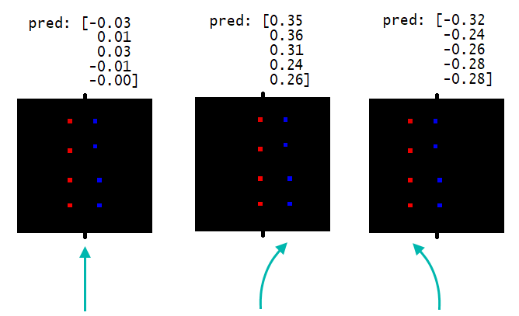
Analysis – ML
Neural Network successfully drives around track
Very error resilient
Centerline of whole track cant be easily determined
Deviation from track center automatically corrected
Notes:
Classical algorithm:
All in all, less and less usable output increasing errors in the input, but if input very precise

Slide 16
Comparison
Machine Learning
High noise tolerance
Produces approximative local centerline
Runtime yields ~16FPS, consistent
Classical
Very brittle
Produces complete accurate centerline or unuseable output
Runtime yields ~1.6FPS, depending on number of cones

Slide 17
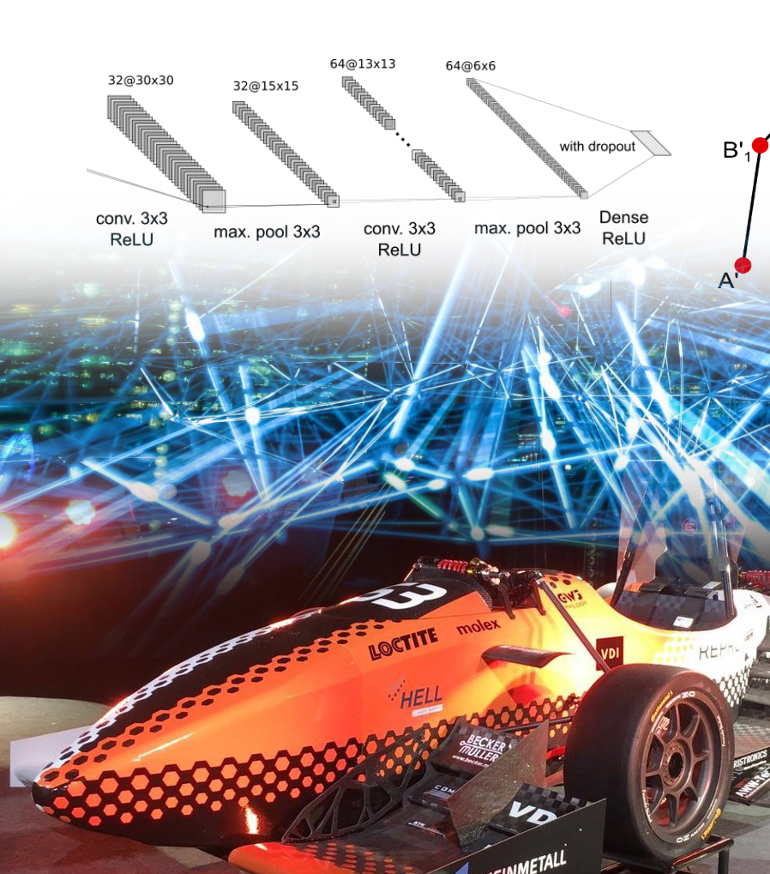
Conclusion
Improvements made classical approach robust
ML useable for real life tests, runtime suitable for realtime, can use in 1st round
Classical map generation once 1st round completed

Slide 18
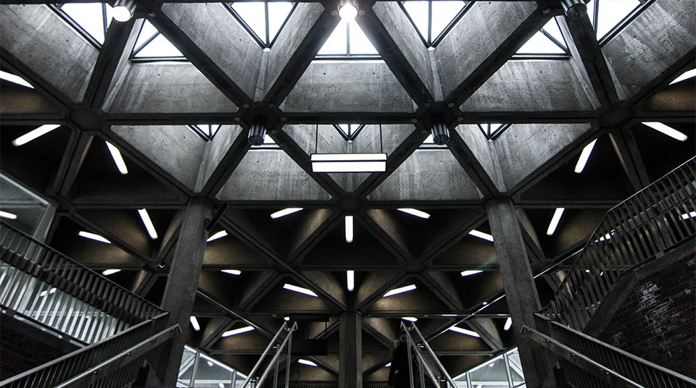
THANK YOU
Any Questions?
Notes:
[show track 1 with 26 mb]

